Slide 1
Data Foundation
Initial Data Ingestion

Slide 2
Our Understanding of your requirements
Current Situation
Landsec have started the process to move to the to-be data platform. At the same time the Analytics team have been starting to move the needle on the analytics within Landsec. To continue with this progress the Analytics team require key data sets to be available.
The Analytics team have initially identified 36 data sources including external and internal data that it requires
The priority of these data sets is expected to change over time inline with the Analytics and Business priorities
Therefore…
Landsec would like a team to ingest and where required model the data so that it can be used by the analytics team
In line with the Data Engineering Foundations, it is expected that each data set will:
Adhere to the ETL Framework
Reside in ‘Justin’s storage’ in flat files and be present in the data lake as delta files
It is expected that each data set will be transformed into the Silver layer to ensure it is usable
Required metadata will be captured for Governance and Lineage

Slide 3
Goals
Quickly enable the Analytics team with new data sets
Create a foundation of data in the new Azure Data Platform
Co-Build with the Landsec Data Engineering team
Validate the to-be platform with real data and use cases

Slide 4
Data Foundation
Proposed Approach

Slide 5


Approach for Each Data Set
Data Sources
Prioritise with Stakeholders
Legend
 | Review
 | Discovery
 | Build
Each Data Set
Explore data sets
Ingest into Bronze (Raw)
Define DQ rules (shared with Steward)
Transform/Cleanse into Silver Layer
Work with Data Vendors/Internal Teams
Create surrogate keys as needed
External Tables
Capture technical metadata
Share and Refine with Business
Data Management
Capture business metadata
Cataloguing and Ownership
Access Management

Slide 6
Sprint Approach
Legend
 | Review
 | Build
Sprint 1-X
Sprint Planning
Sprint Review
Data Set 1
Data Set 2
Data Set 3
ID | Key Aspects
1 | Ingest data from various sources into Justin's SA (Data Transfer)
2 | Sources vary from internal sources (SQL server, REST API, etc.) to external (TBC)
3 | Priority to be reviewed regularly, requests for extraction (sources, timelines etc.) to be adhoc
4 | Effort estimation and extraction plans to be reflected in Jira and reviewed regularly
5 | Work with agility to provide consumable outputs for PoCs
6 | Ability to productionize easily by re-using ingested data and code
Sprint Retro
Data Set 4
Data Set 5
Data Set 6
Backlog Grooming
Analytics team engagement

Slide 7
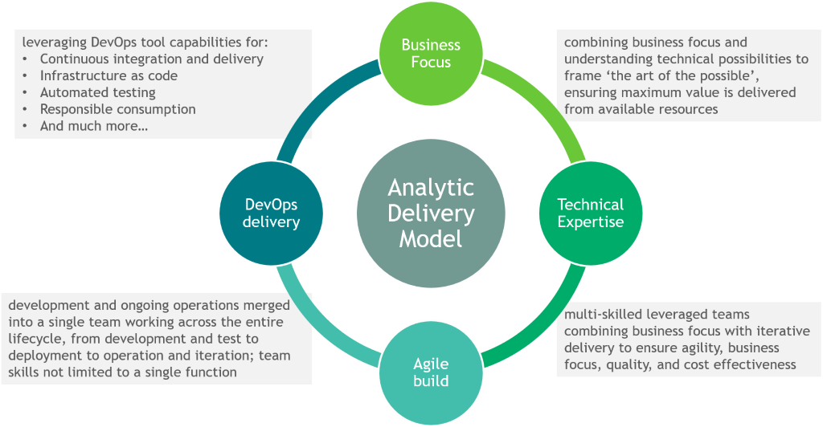
Efficient Execution

Slide 8
Operational Effectiveness
DevOps approach in line with Multi-Dev Environments Framework
DevOps goes hand in hand with agile delivery, shortening the development life cycle and providing continuous delivery with high quality. It enables humans to keep pace with technology advances, and we make the most of it, including:
Continuous integration and continuous deployment approaches (CICD) that allow us to deliver code more frequently and reliably, reducing time to deploy and increasing customer satisfaction
Putting high focus on responsible consumption, linking engineering to the economics of cloud deployment to realise the benefits and avoid un-necessary cost.
A robust code management process to reduce risks, promote collaborative working and bring agility.
This will allow us to easily productionise code to ingest data once the value of the data is proved by the analytics team
Unilever
Diageo
Mars
Coca-Cola European Partners
PepsiCo
Reckitt Benckiser
SABMiller
Johnson & Johnson
Imperial Tobacco
Japan Tobacco
…

Slide 9
Proposed Enhanced Team
Leveraged Team
A self-managed, leveraged team with a strong mix of functional, data, and technical knowledge, providing assured delivery and quality at the right cost.
Onshore Lead/Scrum Master(IN)
Consultant with end-to-end Azure expertise, assisting with design & development. Also, performing Scrum master role
Offshore Lead & Developer (IN)
Consultant with end-to-end Azure expertise, assisting with design & development and supporting the ‘Developer’
Developer (IN) * 2 to 4
Consultant driving development and validation efforts
Days on Project
Decreasing hourly rate
Project Manager
PM from Al Walker’s team managing dependencies with other programmes and addressing issues with data providers
Data Steward (x2)
Consultant with understanding of Data Management techniques and Collibra
Collaborating and partnering with Landsec stakeholders to ensure delivery against business objectives
Collaborating with Data Engineering to ensure alignment to standards

Slide 10
Data Foundation
Initial Data Ingestion

Slide 11
Timeline (Option 1)
Smaller team, extended timelines
Week
0 | 1 | 2 | 3 | 4 | 5 | 6 | 7 | 8 | 9 | 10.. | ..23 | 24 | 25 | 26
Onboard
Review
Sprint 1
Sprint 2-8
Sprint 3-10
Sprint 4-10
PGLS & Documentation
Initial Analysis and Platform Review
Data transformations to prepare ingested data for modelling
Open to users to test functionality of the reporting and validate data
Landscape assessment, Design, Data cleansing and Ingestion
Data Model and Reporting – to help with validation and error reporting
Thorogood will provide support for the application over this period

Slide 12
Timeline (Option 2)
Larger team, shorter timelines
ASSUMPTION: little to no investigation needed for data sources
Week
0 | 1 | 2 | 3 | 4 | 5 | 6 | 7 | 8 | 9 | 10 | 11 | 12 | 13 | 14
Onboard
Review
Sprint 1
Sprint 2
Sprint 3
Sprint 4
PGLS & Documentation
Initial Analysis and Platform Review
Data transformations to prepare ingested data for modelling
Open to users to test functionality of the reporting and validate data
Landscape assessment, Design, Data cleansing and Ingestion
Data Model and Reporting – to help with validation and error reporting
Thorogood will provide support for the application over this period

Slide 13
Costs
Estimates
Options | Timelines | Est. Cost
Option 1 Option 2 | 6 months 3 months | £ 594,500 £ 381,900
*Note: Costs Exclusive of VAT and Expenses and Hosting Fees
Team Profile
Onshore Lead and Scrum Master | Senior Onshore Consultant to manage the project, design lead and QA
Offshore Team Lead | Senior Offshore Consultant with ownership of managing day to day development activities of the development team
Offshore Developer * (2-4) | Consultants responsible for developing Azure components and application setup/configuration and performing Power BI development

Slide 14
Costs Breakdown
Estimates
Company | Consultant | Option 1 (6 months) | Option 2 (3 months)
Thorogood | Onshore lead (Level D / UK) Onshore consultant (Level H / UK) Offshore lead (Level D / IN) Offshore developer (Level G / IN) Offshore developer (Level H / IN) Offshore developer (Level H / IN) Offshore developer (Level I / IN) Total Thorogood | 0.5 dpw / £ 29,200 3 dpw / £ 80,800 1.5 dpw / £ 40,100 4.5 dpw / £ 75,200 5 dpw / £ 69,200 £ 294,500 | 0.75 dpw / £ 22,000 3 dpw / £ 40,400 2 dpw / £ 33,500 4.5 dpw / £ 37,600 5 dpw / £ 34,600 5 dpw / £ 34,600 5 dpw / £ 29,400 £ 231,900
Kubrick | Onshore Steward | £160,000 | £ 80,000
Contractor | Onshore PM | £ 100,000 | £ 50,000
Platform team (Extrinsica?) | Onshore | £ 40,000 | £ 20,000

Slide 15
Assumptions & Dependencies
Assumptions
Environment to be setup (Data Lake Storage Gen 2, Data Factory, Databricks, Synapse workspace, Key Vault, and connections between resources) prior to the start of the engagement
Access to be provided to internal systems and any additional data sources to be ingested for all team members and azure resources
Effort for data ingestion are high level estimates which could change based on analysis to understand details and challenges for each dataset
Dependencies
Availability and engagement of key business stakeholders for the requirements gathering sessions and platform review
Availability and engagement of IT stakeholders to provide information on source systems, data formats, etc. as well as any data, security, and systems considerations
Connectivity to Landsec systems can be provided to the Thorogood on-shore and off-shore team

Slide 16
Appendix
Datasource complexity estimate

Slide 17
Data Sets and Estimated mix of complexity
Sources |  | Complexity (H/M/L) | Effort (days)
"Internal" | PIMS - Lettings / Voids | L | 4
 | PIMS - Property Master Data | L | 4
 | CODA - Service Charge (subset of P2P) | L | 4
 | CODA - AR | L | 4
 | CODA - P2P, inc. Commitment | L | 4
 | CODA - Manual Journals | L | 4
 | CODA - Utilities | L | 4
 | RA - Sales | L | 4
 | RA - Footfall | L | 4
 | EMS / Optima - all sites | H | 12
 | BMS | H | 12
 | Brainbox AI | M | 8
 | Office Utilisation | M | 8
 | Air Things | M | 8
 | SkyFii | H | 12
 | Invida | H | 12
 | RiskWise | H | 12
 | FM Systems (3rd Party) | H | 12
 | Valuation (PIMS?) / Market Yield / ERV | M | 8
 | FP&A/MRI | M | 8
 | CRM | M | 8
 | CVAs/Admins | M | 8
"External" | Market Size | L | 4
 | Spend | M | 8
 | Mobility | M | 8
 | Search | M | 8
 | Social Media | H | 12
 | Job Vacancies | M | 8
 | Residential Rents/Availability | L | 4
 | Restaurant Reservations | L | 4
 | Public Transport Usage | M | 8
 | Road Congestion | L | 4
 | Airport Passenger Levels | L | 4
 | Commercial Transactions | H | 12
 | Commercial Rents | M | 8
 | Demographics | M | 8
 | Total |  | 264

